Slide 1
Evaluation Techniques

Slide 2
Evaluation Techniques
Evaluation
  tests usability and functionality of system
  occurs in laboratory, field and/or in collaboration with users
  evaluates both design and implementation
  should be considered at all stages in the design life cycle

Slide 3
Goals of Evaluation
assess extent of system functionality
assess effect of interface on user
identify specific problems

Slide 4
Evaluating Designs
Cognitive Walkthrough
Heuristic Evaluation
Review-based evaluation

Slide 5
Task- Centered Design
Task-centered design focuses on REAL, COMPLETE, REPRESENTATIVE tasks.
Traditional requirements analysis looks at ABSTRACT, PARTIAL task elements.
How to evaluate a design without users? One approach is a cognitive walkthrough.

Slide 6
Cognitive Walkthrough
Proposed by Polson et al.
  evaluates design on how well it supports user in learning task
  usually performed by expert
  Identify problems based on psychological principles
  Requires some expertise in cognitive psychology
  forms used to guide analysis
  Polsom P., Lewis, C., Rieman, J., and Wharton, C. (1992). Cognitive walkthroughs: A method for theory-based evaluation of user interfaces

Slide 7
Cognitive Walkthrough (ctd)
For each task walkthrough considers
  what impact will interaction have on user?
  what cognitive processes are required?
  what learning problems may occur?
Analysis focuses on goals and knowledge: does the design lead the user to generate the correct goals?

Slide 8
Cognitive walkthrough
Formalized way of imagining people's thoughts and actions when they use an interface for the first time.
First select a task that the design is intended to support.
Then try to tell a believable story about each action a user has to take to do the task.
To make the story believable, you have to motivate each of the user's actions, relying on the user's general knowledge and on the prompts and feedback provided by the interface. If you can't tell a believable story about an action, then you've located a problem with the interface

Slide 9
Cognitive walkthrough
Select tasks
Write-down the desired path
4 questions to ask:
  Will the customer realistically be trying to do this action? (Is effect of current action same as user’s goal? – conceptual model)
  Is the control for the action visible?
  Is there a strong link between the control and the action? (Will user recognize action as the correct one?)
  Is feedback appropriate? (Will user understand feedback?)
http://www.userfocus.co.uk/articles/cogwalk.html, 2010

Slide 10
Cognitive walkthrough
No need for users
Explicit account of user’s task
Suggestions to improve learnability
Any phase
Quick and inexpensive
Expertise skills / evaluator effect
Tends to focus on words and graphics
No frequency and severity of problem
Artificial context

Slide 11
Heuristic Evaluation
Proposed by Nielsen and Molich.
usability criteria (heuristics) are identified
design examined by experts to see if these are violated
Example heuristics
  system behaviour is predictable
  system behaviour is consistent
  feedback is provided
Heuristic evaluation ‘debugs' design.

Slide 12
Heuristic Evaluation
Several (3 to 5) evaluators independently critique a system to come up with potential usability problems.
Relatively cheap approach--- Discount usability technique
A set of 10 heuristics are provided to aid the evaluators in discovering usability problems.
Heuristics are almost same like the principles and guidelines.

Slide 13
Heuristic evaluation
Developed by Jakob Nielsen
Heuristics → general principles for interaction design
  Adjusted versions for particular cases
Identify where design does not follow these principles
Requires some expertise in usability (3-5 evaluators)
  independently check for compliance with usability principles (“heuristics”)
  different evaluators will find different problems
  evaluators only communicate afterwards
  findings are then aggregated
Nielsen, J. (1994). Heuristic evaluation

Slide 14
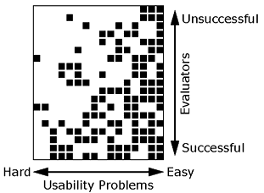
Why Multiple Evaluators?
Every evaluator doesn’t find every problem
Good evaluators find both easy & hard ones
2/25/2002

Slide 15
Heuristic evaluation process
Select system and tasks to review
Select heuristic set
Inspect the interface alone
Communicate and aggregate findings
Categorize and prioritize findings to be effectively reported

Slide 16
Severity Rating of HE
The severity of a usability problem is a combination of three factors:
    The frequency with which the problem occurs: Is it common or rare?
    The impact of the problem if it occurs: Will it be easy or difficult for the users to overcome?
    The persistence of the problem: Is it a one-time problem that users can overcome once they know about it or will users repeatedly be bothered by the problem?

Slide 17
Severity Rating of HE
The following 0 to 4 rating scale can be used to rate the severity of usability problems:
  0 = I don't agree that this is a usability problem at all
  1 = Cosmetic problem only: need not be fixed unless extra time is available on project
  2 = Minor usability problem: fixing this should be given low priority
  3 = Major usability problem: important to fix, so should be given high priority
  4 = Usability catastrophe: imperative to fix this before product can be released

Slide 18
Heuristic evaluation
Relatively inexpensive (incl. planning)
Expert skills are not a must
Can be used early, but more efficient later
Evaluator effect (thus, multiple are needed)
Not as effective as usability testing (minor issues)
Not always readily suggest solutions
Prone to false alarms

Slide 19
Heuristic Evaluation Guidelines
Nielsen’s 10 principles
Shneiderman’s 8 golden rules
Tognazzini’s 16 principle

Slide 20
Nielsen’s 10 Heuristics
1. Visibility of system status
2. Match between system and the real world
3. User control and freedom
4. Consistency and standards
5. Error prevention
6. Recognition rather than recall
7. Flexibility and efficiency of use
8. Aesthetic and minimalist design
9. Help users recognize, diagnose, and recover from errors
10. Help and documentation

Slide 21
1. Visibility of system status
Provide users timely and appropriate feedback about the system’s status.
Does the system tell the users
  what operation it is performing?
  how much longer they need to wait?
  which mode it is in?
  Example: If it takes a long time to load a screen, display a progress bar and/or an estimate of the time it may take to load, so users know what to expect.

Slide 22
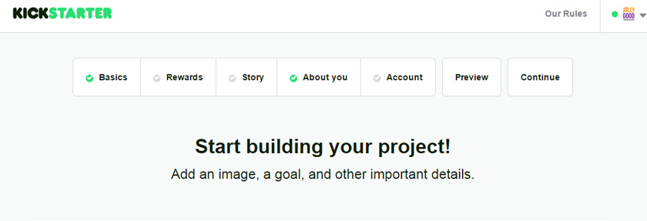
1. Visibility of system status

Slide 23
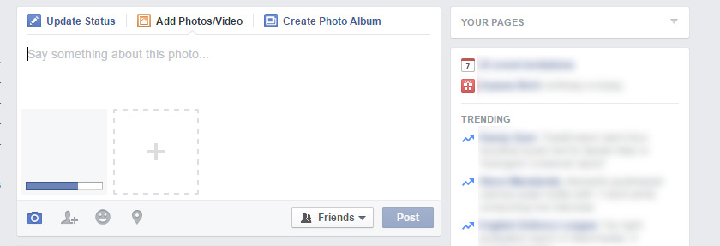
1. Visibility of system status

Slide 24
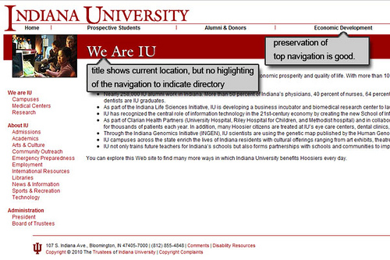
1. Visibility of system status

Slide 25
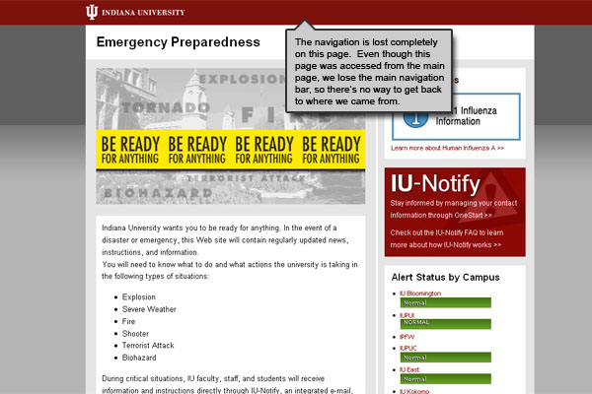
1. Visibility of system status

Slide 26
2. Match between system and the real world
Speak the user’s language using terms and concepts that are familiar to the intended audience. Information should be organized naturally and logically based on what users are accustomed to seeing in the real world.
Does the system
  speak users’ language?
  follow real world convention?
Example: When designing a website for children, use terms with which they are familiar and display information in formats they are used to seeing.

Slide 27
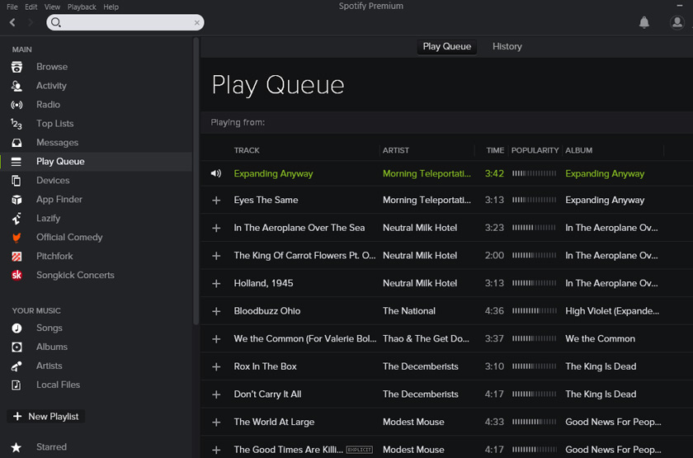
2. Match between system and the real world

Slide 28
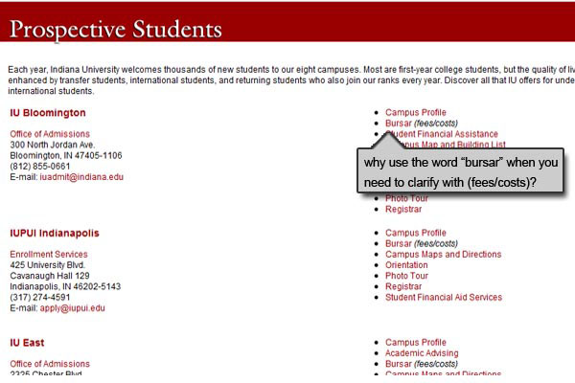
2. Match between system and the real world

Slide 29
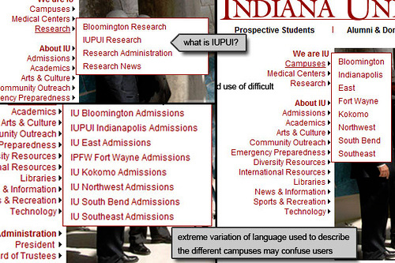
2. Match between system and the real world

Slide 30
3. User Control and Freedom
Users should experience perceived control as they interact with the system. Users should have the ability to “go back” and fix mistakes without hassle.
Does the system
  provide clearly marked exists?
  support undo and redo
Example: Provide the functionality to Undo and Redo actions and to easily exit the system.

Slide 31
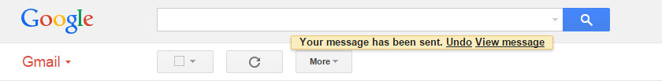
3. User Control and Freedom

Slide 32
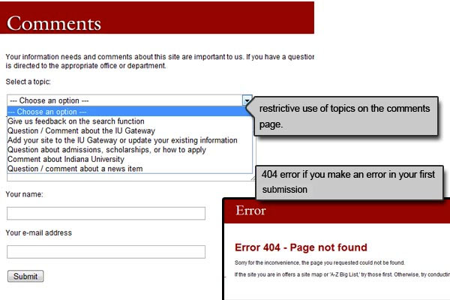
3. User Control and Freedom

Slide 33
4. Consistency and Standards
User controls, icons, terminology, and error messaging should be consistent throughout the interface. Where appropriate, industry and platform standards should be applied.
Does the system use the same term to refer to the same thing?
Does the system let users perform the same action by the same UI?
Example: Use icons with which people are familiar, rather than creating new designs that mean the same thing. Users are more likely to be scanning around the page for the phrase “About Us” than “Get to know the team”.

Slide 34
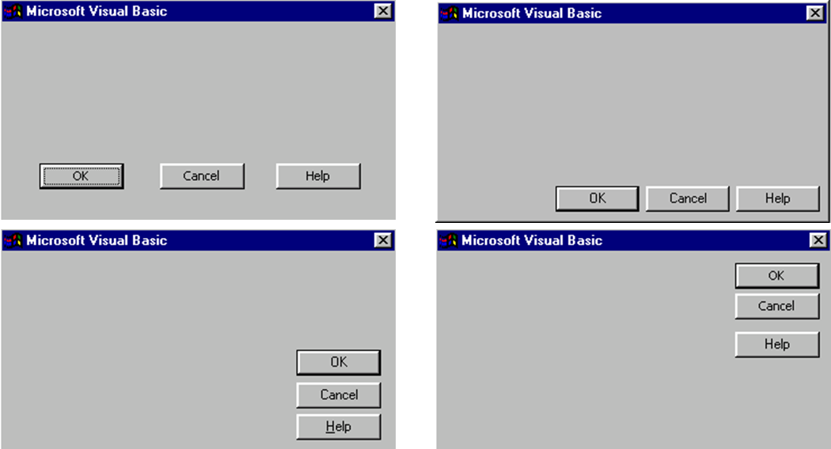
4. Consistency and Standards

Slide 35
5. Error Prevention
Prevent user errors by identify problem areas for typical users and re-designing it to more clearly communicate the consequences of users’ actions.
When deleting information that may be difficult to recreate, offer users a confirmation to delete the data. Additionally, provide the ability to Undo actions that users could accidentally commit and, consequently, lose important information.
Does the system eliminate or check for error-prone conditions?
Example: does an email client help users avoid common errors such as
– typing the wrong address
– making spelling mistakes
– missing an attachment

Slide 36
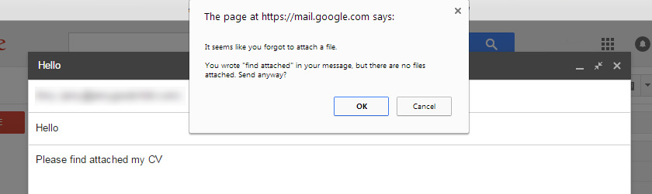
5. Error Prevention

Slide 37
6. Recognition rather than recall
Reduce the memory load of users by presenting familiar icons, actions, and options whenever possible.
Do not require the user to recall information from one screen to another.
Use mouse-over tooltips to describe the functionality of icons which may be unfamiliar.
Does the system present options for users to recognize the one they want?
Example: On a web form, allow easy access to previously entered information, such as serial numbers, so the user does not need to recall the information or write it down.

Slide 38
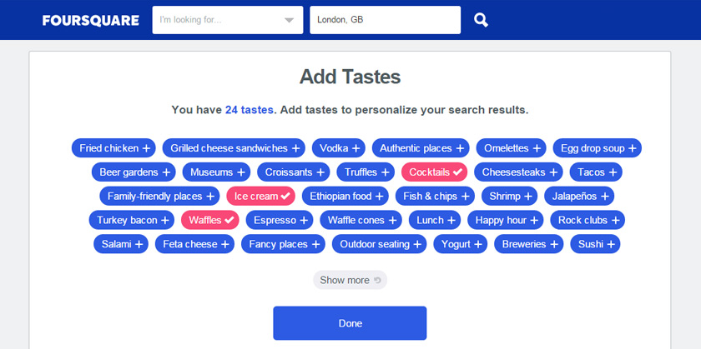
6. Recognition rather than recall

Slide 39
7. Flexibility and efficiency of use
Novice and expert users use systems differently. The system should be easy and efficient to use by novices and experts alike.
Provide “accelerators” for expert users to more efficiently navigate your application to complete the most frequent tasks.
Does the system provide ways for users to access a file or application quickly?
Does the system provide shortcuts users can learn to do things faster?
Example: An accelerator can be a keystroke shortcut, such as Macintosh’s Command+Q to quit an application.

Slide 40
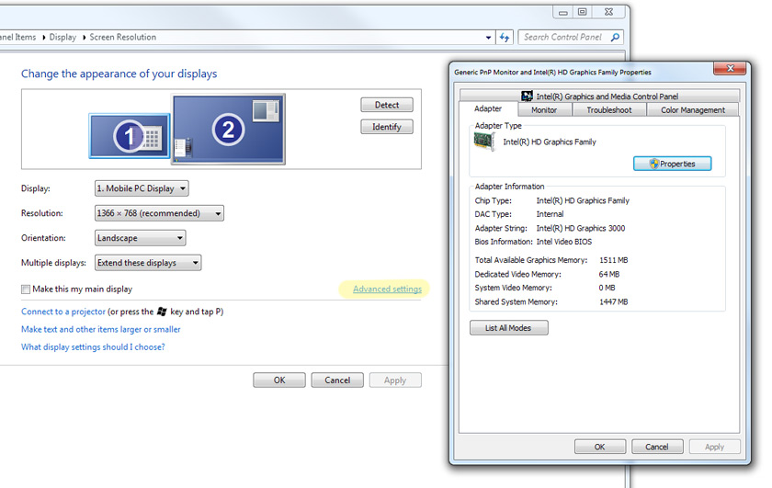
7. Flexibility and efficiency of use

Slide 41
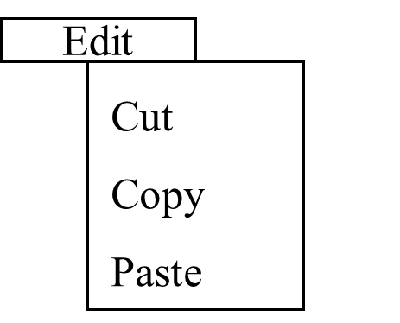
7. Flexibility and efficiency of use
KB Shortcut:
Ctrl + X
Ctrl + C
Ctrl + V

Slide 42
8. Aesthetic and minimalist design
Avoid displaying excessive information and design elements, as they will visually compete with more relevant information on the screen.
Does the system minimize irrelevant or rarely needed elements?
Does the system look aesthetically appealing?
Example: Background graphics can make viewing text difficult.

Slide 43
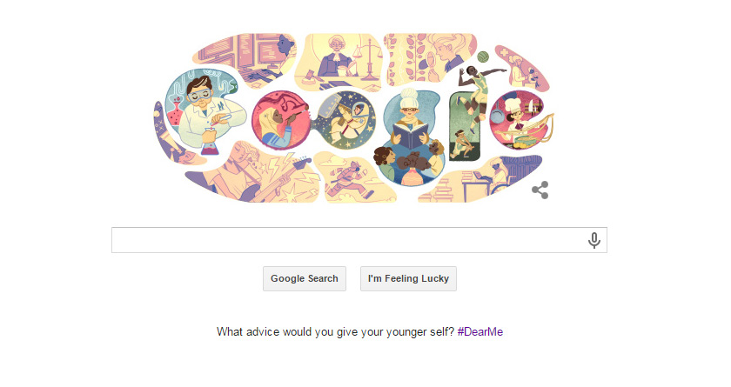
8. Aesthetic and minimalist design

Slide 44
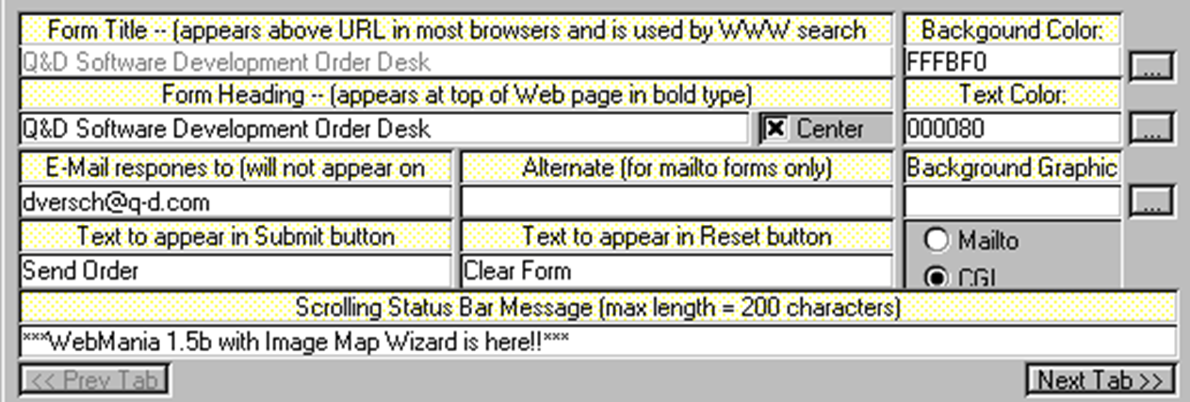
8. Aesthetic and minimalist design

Slide 45
9. Help Users Recognize, Diagnose, and Recover from Errors
Present error messages that give users instructions about how to recover from an error, rather than cryptic codes that users do not understand.
Does the system explain well why an error occurs and how to fix it?
Example: If the user enters an invalid email address on a web form that requests the address, the error message could read, “That email address is not in our records. Please enter an email address in this format: email@address.com.”

Slide 46
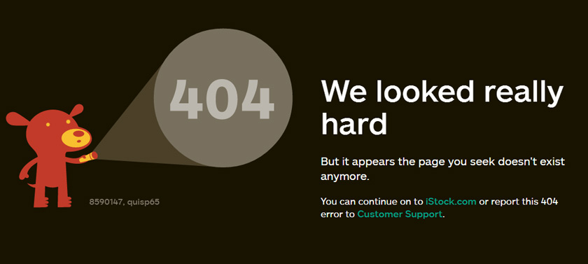
9. Help Users Recognize, Diagnose, and Recover from Errors

Slide 47
10. Help and Documentation
It is usually best to design an interface to be so simple to use that Help and Documentation is unnecessary; however, there may be times when it is necessary to access Help.
In those cases, Help documentation and user support should be easy to search, and instructions should be easy to follow.
It may be useful to provide video tutorials and examples for complex procedures or controls that are hard to locate.
Does the system help? Does the system provide help where and when it is needed? Is the system adequately documented?
Example: If there is not enough reason to produce an entire Help section, and there are a couple form fields that may be confusing to some users, it is appropriate to include “in-line help” in the form of a link that opens a small help dialogue next to the form field. Alternatively, next to a form field text box or field label, provide users an example of how to input the information using the required formatting, such as entering a phone number as xxx-xxx-xxxx.

Slide 48
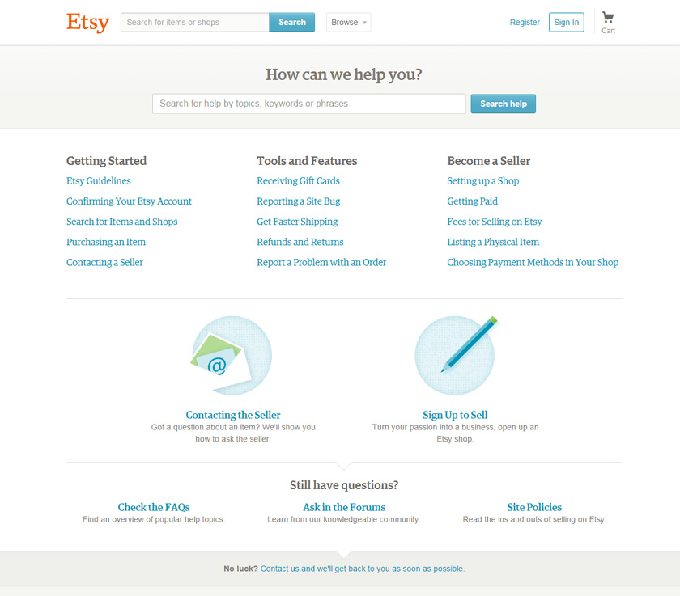
10. Help and Documentation

Slide 49
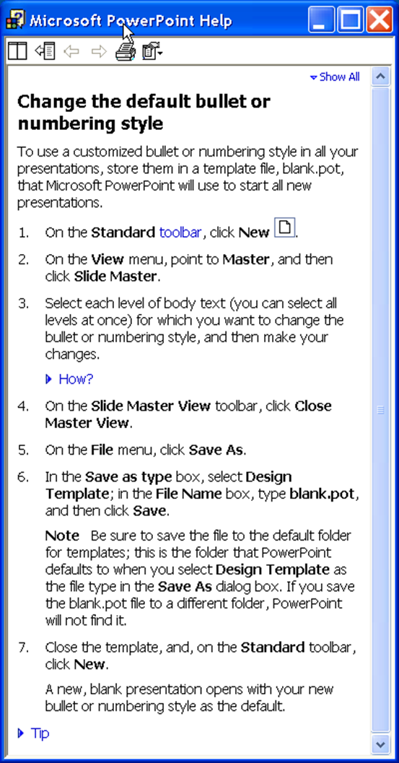
10. Help and Documentation

Slide 50
Heuristic evaluation
10 Usability Heuristics Video:
https://www.youtube.com/watch?v=hWc0Fd2AS3s

Slide 51
Further Reading Materials (Must-Read)
Nielsen's papers on his website: http://www.useit.com/papers/heuristic/
1 document (given during the lecture slides)
http://designmodo.com/usability-heuristic-evaluation/
http://www.mattsoave.com/old/cogs187a/iu_site_eval/1visibility.html
Search in Google and read articles/blog/documents related to heuristic evaluation and its example cases.

Slide 52
Review-based evaluation
Results from the literature used to support or refute parts of design.
Care needed to ensure results are transferable to new design.
Model-based evaluation
Cognitive models used to filter design options
  e.g. GOMS prediction of user performance.
Design rationale can also provide useful evaluation information

Slide 53
Evaluating through user Participation

Slide 54
Evaluating through User Participation
Laboratory studies
Field studies

Slide 55
Laboratory studies
Advantages:
  specialist equipment available
  uninterrupted environment
Disadvantages:
  lack of context
  difficult to observe several users cooperating
Appropriate
  If system location is dangerous or impractical (space station)
  For constrained single-user tasks (systems)
  To allow controlled manipulation of use
  To compare alternative designs within a controlled context

Slide 56
Field Studies
Advantages:
  natural environment
  context retained (though observation may alter it)
  longitudinal studies possible
Disadvantages:
  distractions
  noise
Appropriate
  where context is crucial for longitudinal studies

Slide 57
Evaluating Implementations
Requires an artefact:
  simulation
  prototype
  full implementation

Slide 58
Experimental Evaluation
Controlled evaluation of specific aspects of interactive behaviour
Evaluator chooses hypothesis to be tested
A number of experimental conditions are considered which differ only in the value of some controlled variable.
Changes in behavioural measure are attributed to different conditions

Slide 59
Experimental factors
Subjects/participants
  who – representative, sufficient sample
Variables
  things to modify and measure
Hypothesis
  what you’d like to show
Experimental design
  how you are going to do it

Slide 60
Participants
Choice of participants is vital to the success of any experiment
Should be chosen to match the expected user population as closely as possible
Computer science UG students are not a good choice to test an application developed for general public.
Sample size must be large enough to be representative of population, taking into account the design of the experiment and the statistical methods chosen.

Slide 61
Variables
Independent Variable (IV)
  characteristic changed to produce different conditions
  e.g. interface style, number of menu items
Dependent Variable (DV)
  characteristics measured in the experiment
  e.g. time taken, number of errors.

Slide 62
Hypothesis
prediction of outcome
  framed in terms of IV and DV
  e.g. “error rate will increase as font size decreases”
null hypothesis:
  states no difference between conditions
  aim is to disprove this
  e.g. null hyp. = “no change with font size”

Slide 63
Experimental design
within groups design
  each subject performs experiment under each condition.
  transfer of learning possible
  less costly and less likely to suffer from user variation.
between groups design
  each subject performs under only one condition
  no transfer of learning
  more users required
  variation can bias results.

Slide 64
Analysis of data
Before you start to do any statistics:
  look at data
  save original data
Choice of statistical technique depends on
  type of data
  information required
Type of data
  discrete - finite number of values
  continuous - any value

Slide 65
Analysis - types of test
parametric
  assume normal distribution
  robust
  powerful
non-parametric
  do not assume normal distribution
  less powerful
  more reliable
contingency table
  classify data by discrete attributes
  count number of data items in each group

Slide 66
Analysis of data (cont.)
What information is required?
  is there a difference?
  how big is the difference?
  how accurate is the estimate?
Parametric and non-parametric tests mainly address first of these

Slide 67
Experimental studies on groups
More difficult than single-user experiments
Problems with:
  subject groups
  choice of task
  data gathering
  analysis

Slide 68
Subject groups
larger number of subjects
⇒ more expensive
longer time to `settle down’
… even more variation!
difficult to timetable
so … often only three or four groups

Slide 69
The task
must encourage cooperation
perhaps involve multiple channels
options:
  creative task e.g. ‘write a short report on …’
  decision games e.g. desert survival task
  control task e.g. ARKola bottling plant

Slide 70
Data gathering
several video cameras
+ direct logging of application
problems:
  synchronisation
  sheer volume!
one solution:
  record from each perspective

Slide 71
Analysis
N.B. vast variation between groups
solutions:
  within groups experiments
  micro-analysis (e.g., gaps in speech)
  anecdotal and qualitative analysis
look at interactions between group and media
controlled experiments may `waste' resources!
Notes:
Anecdotal evidence can be in the form of a shared experience or a narrative that makes a point. A neighbor's experience with their doctor, their review of a school, or a three star online rating of a hotel stay are all examples of anecdotal evidence

Slide 72
Field studies
Experiments dominated by group formation
Field studies more realistic:
  distributed cognition ⇒ work studied in context
  real action is situated action
  physical and social environment both crucial
Contrast:
  psychology – controlled experiment
  sociology and anthropology – open study and rich data

Slide 73
Observational Methods
Think Aloud
Cooperative evaluation
Protocol analysis
Automated analysis
Post-task walkthroughs

Slide 74
Think Aloud
user observed performing task
user asked to describe what he is doing and why, what he thinks is happening etc.
Advantages
  simplicity - requires little expertise
  can provide useful insight
  can show how system is actually use
Disadvantages
  subjective
  selective
  act of describing may alter task performance

Slide 75
Cooperative evaluation
variation on think aloud
user collaborates in evaluation
both user and evaluator can ask each other questions throughout
Additional advantages
  less constrained and easier to use
  user is encouraged to criticize system
  clarification possible

Slide 76
Protocol analysis
Methods for recording user actions include the following:
paper and pencil – cheap, limited to writing speed
audio – good for think aloud, difficult to match with other protocols
video – accurate and realistic, needs special equipment, obtrusive
computer logging – automatic and unobtrusive, large amounts of data difficult to analyze
user notebooks – coarse and subjective, useful insights, good for longitudinal studies
Mixed use in practice.
audio/video transcription difficult and requires skill.
Some automatic support tools available

Slide 77
automated analysis – Experimental Video Annotator (EVA)
Workplace project
Post task walkthrough
  user reacts on action after the event
  used to fill in intention
Advantages
  analyst has time to focus on relevant incidents
  avoid excessive interruption of task
Disadvantages
  lack of freshness
  may be post-hoc interpretation of events

Slide 78
post-task walkthroughs
transcript played back to participant for comment
  immediately → fresh in mind
  delayed → evaluator has time to identify questions
useful to identify reasons for actions and alternatives considered
necessary in cases where think aloud is not possible

Slide 79
Query Techniques
Interviews
Questionnaires

Slide 80
Interviews
analyst questions user on one-to -one basis
usually based on prepared questions
informal, subjective and relatively cheap
Advantages
  can be varied to suit context
  issues can be explored more fully
  can elicit user views and identify unanticipated problems
Disadvantages
  very subjective
  time consuming

Slide 81
Questionnaires
Set of fixed questions given to users
Advantages
  quick and reaches large user group
  can be analyzed more rigorously
Disadvantages
  less flexible
  less probing

Slide 82
Questionnaires (ctd)
Need careful design
  what information is required?
  how are answers to be analyzed?
Styles of question
  general
  open-ended
  scalar
  multi-choice
  ranked

Slide 83
Physiological methods
Eye tracking
Physiological measurement

Slide 84
eye tracking
head or desk mounted equipment tracks the position of the eye
eye movement reflects the amount of cognitive processing a display requires
measurements include
  fixations: eye maintains stable position. Number and duration indicate level of difficulty with display
  saccades: rapid eye movement from one point of interest to another
  scan paths: moving straight to a target with a short fixation at the target is optimal

Slide 85
physiological measurements
emotional response linked to physical changes
these may help determine a user’s reaction to an interface
measurements include:
  heart activity, including blood pressure, volume and pulse.
  activity of sweat glands: Galvanic Skin Response (GSR)
  electrical activity in muscle: electromyogram (EMG)
  electrical activity in brain: electroencephalogram (EEG)
some difficulty in interpreting these physiological responses - more research needed

Slide 86
Choosing an Evaluation Method
when in process: design vs. implementation
style of evaluation: laboratory vs. field
how objective: subjective vs. objective
type of measures: qualitative vs. quantitative
level of information: high level vs. low level
level of interference: obtrusive vs. unobtrusive
resources available: time, subjects,
equipment, expertise

